Slide 1
Mantid at ORNL: Current Status and Future Directions
Garrett E. Granroth
Neutron Data Analysis and Visualization Division

Slide 2
Overview
Instrument usage summary
More instruments using Mantid
RefM, NOMAD, BioSANS, HB3A
Accessing Mantid from multiple interfaces
Qt, web, DAQ, Python, Jupyter, MantidPlot
More HFIR support in the future
Wand²
Improved data structures, and file formats
Better, and more reliance on, metadata
Current examples
Vision for the future
Mantid preparation for the future

Slide 3
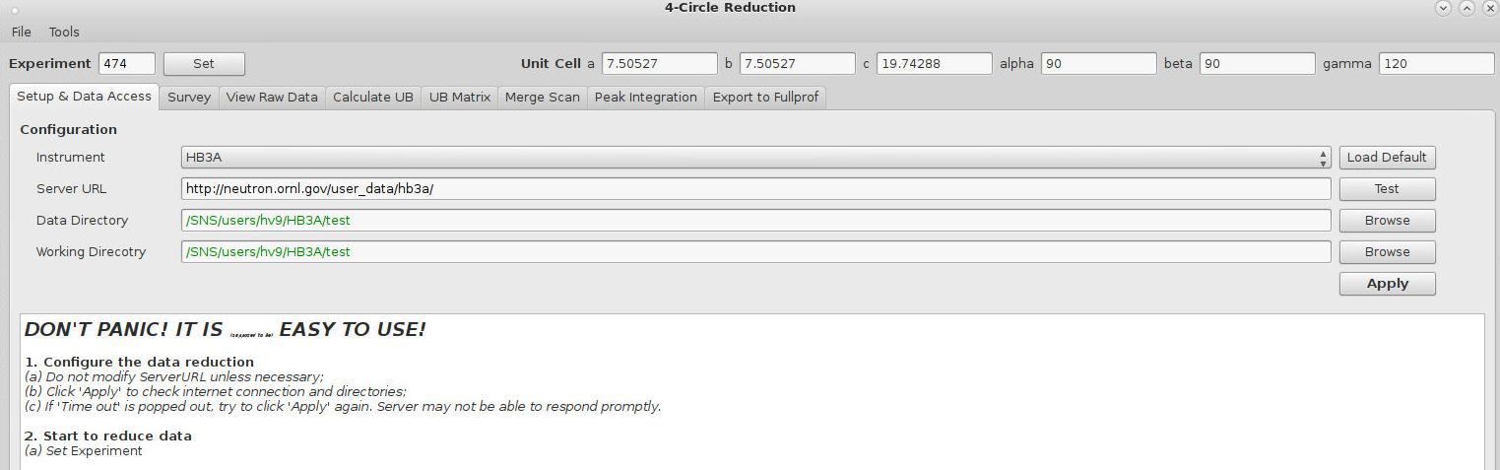
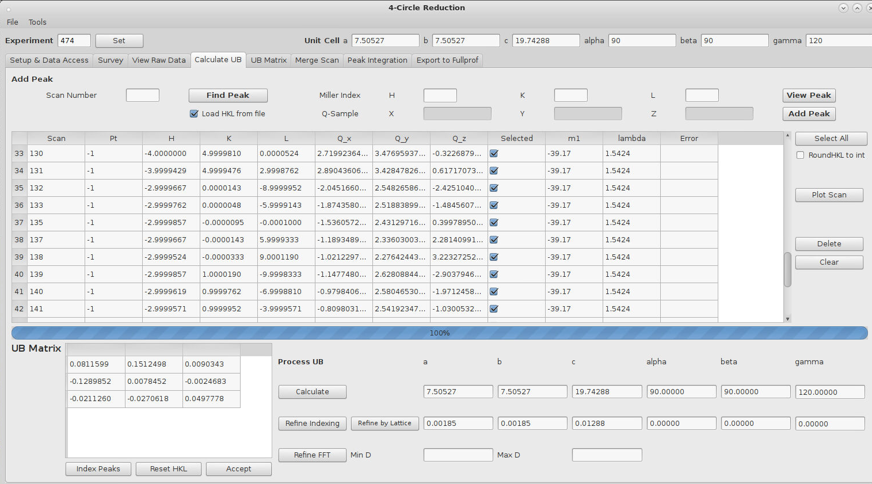
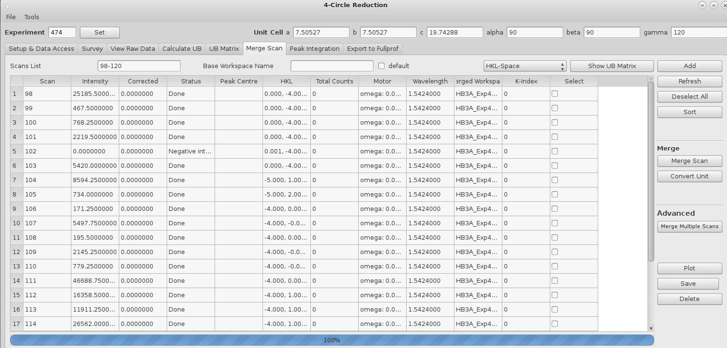
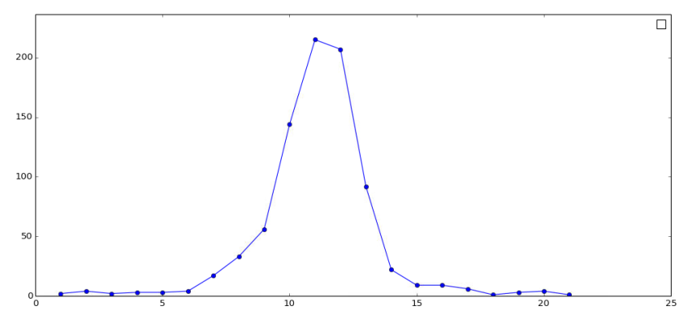
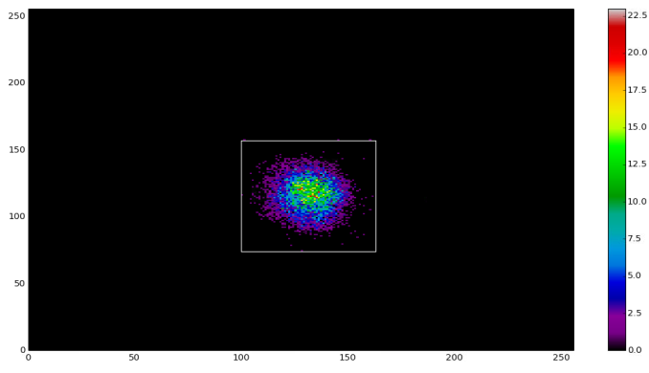
Mantid usage at ORNL - HFIR
KEY
PYTHON – Python without Mantid, could leverage Mantid in the future.
Other – Not Python nor Mantid
DEV – transitioning to using Mantid
GUI – use `mantidplot` directly
MANPY – `import mantid` in generic python scripts, including ipython/jupyter notebooks
WEB – use mantid as part of web based reduction
AUTO – use autoreduction
LIVE – use live-reduction
EXT – Use Mantid in a pythyon/QT app
CG-1D – PYTHON
GP-SANS – MANPY/Other
BIO-SANS – MANPY/WEB
CTAX, PTAX, FIE-TAX,TAX – PYTHON/Other
IMAGINE – Other
HB-2A – Other
HB-2B – PYTHON/DEV
WAND2 – Other/DEV
HB-3A – GUI/DEV

Slide 4
Mantid usage at ORNL – SNS
USANS – AUTO
NOMAD – DEV/EXT/GUI/AUTO/LIVE
BASIS – AUTO/GUI
SNAP – DEV/AUTO/GUI
REFM – AUTO/MANPY/DEV/Other
REFL – AUTO/EXT
EQSANS – MANPY/GUI
VULCAN – DEV/EXT
CORELLI – AUTO/GUI/MANPY/LIVE
POWGEN – AUTO/GUI/LIVE
MANDI – GUI/MANPY
TOPAZ – GUI/MANPY/LIVE
VISION – AUTO/MANPY
ARCS, CNCS, HySPEC, SEQUOIA - AUTO/MANPY
KEY
PYTHON – Python without Mantid, could leverage Mantid in the future.
Other – Not Python nor Mantid
DEV – transitioning to using mantid
GUI – use `mantidplot` directly
MANPY – `import mantid` in generic python scripts, including ipython/jupyter notebooks
WEB – use mantid as part of web based reduction
AUTO – use autoreduction
LIVE – use live-reduction
EXT – Use Mantid in a pythyon/QT app

Slide 5
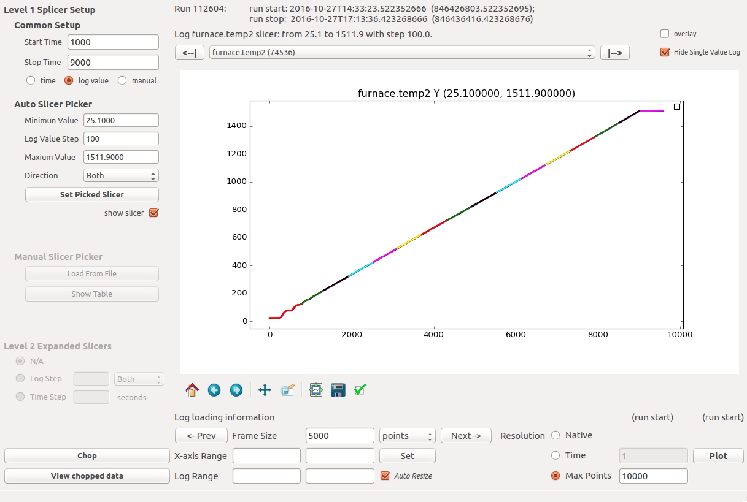
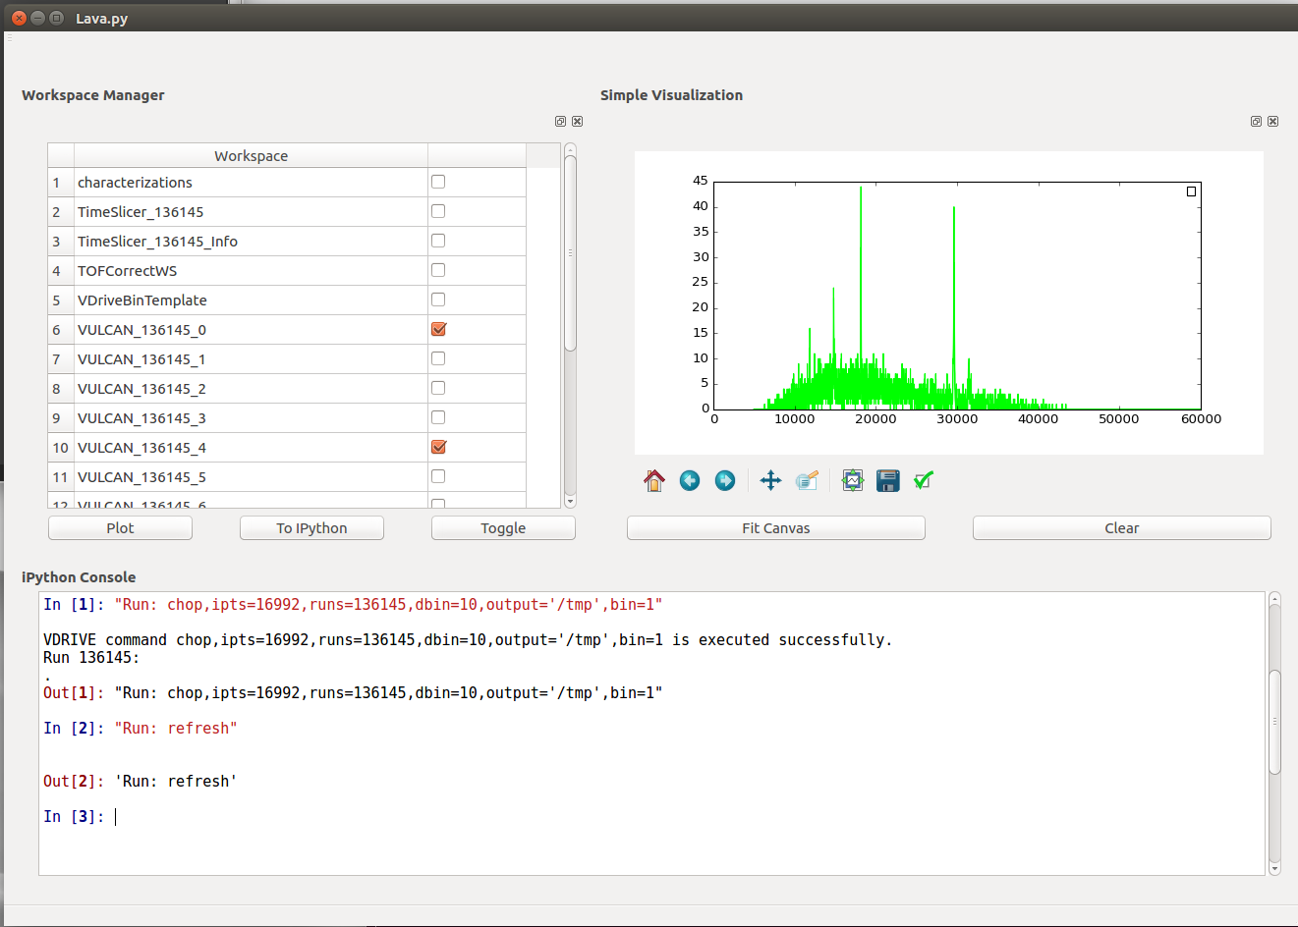
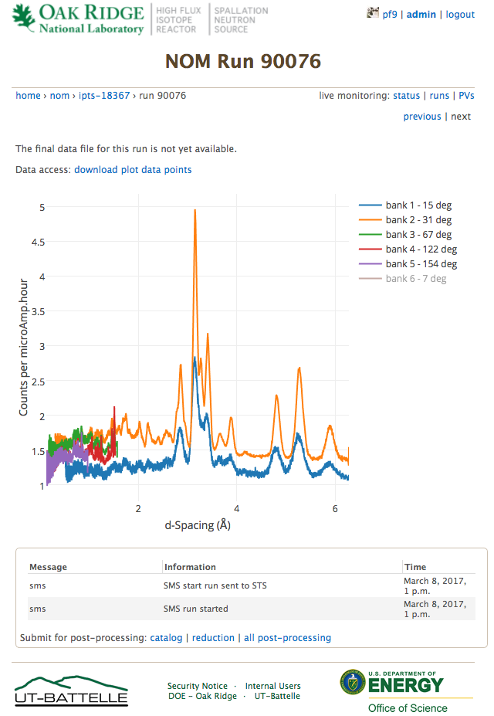
Multiple Interfaces
pyQt Interfaces
PyVdrive (Vulcan)
Advanced Event Filtering interface
FastGr /Addie (NOMAD)
Widgets ready for inclusion in Mantid 4.0
Web interfaces
SANS
Live Data
monitor.sns.gov
Working from within our data acquisition system
Experiment setup for DGS
Notes:
Event filtering and other for Vulcan
Sans interface
Single crystal alignment tool in CSS
Live data for NOMAD

Slide 6
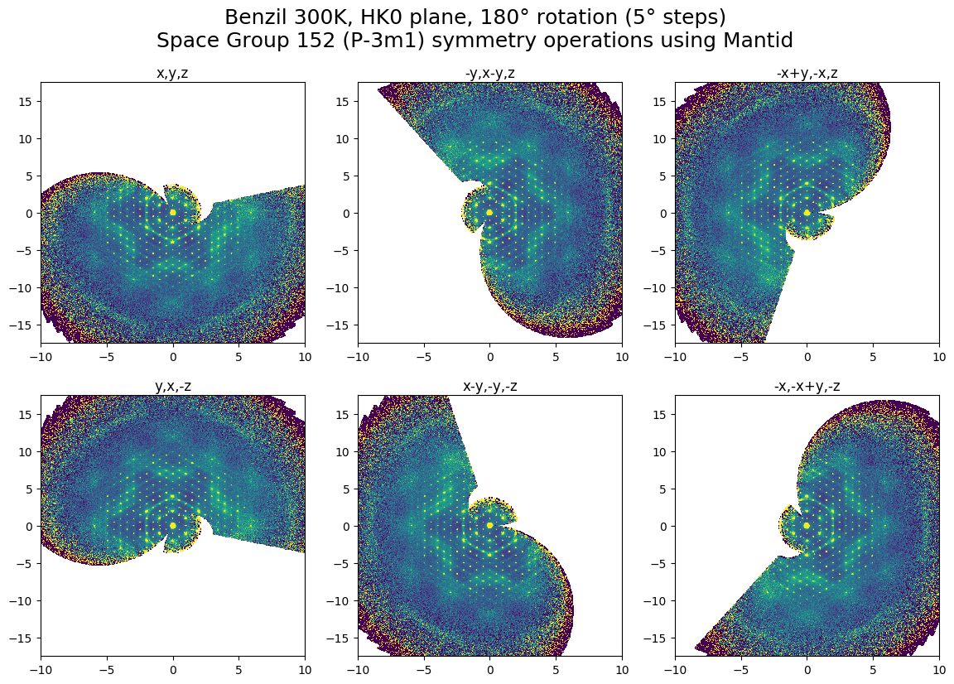
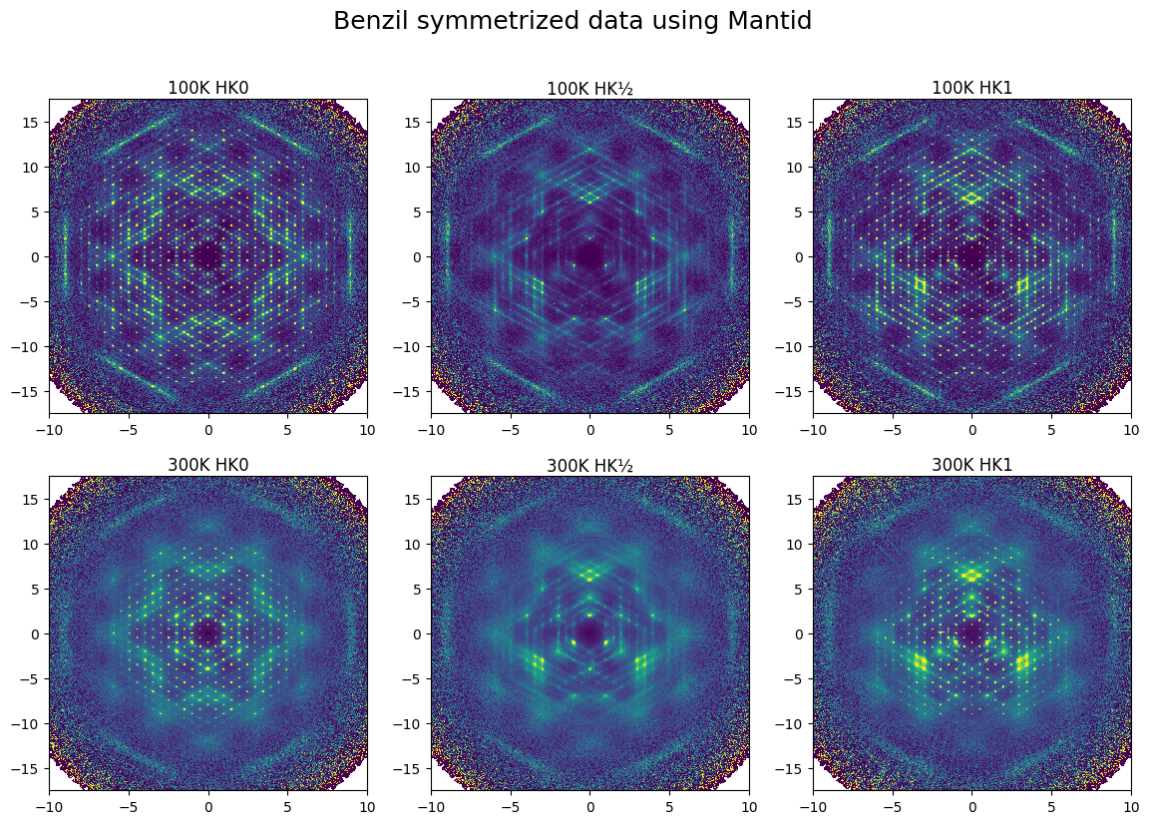
MD workspaces and 3D vis improvements
MD workspaces
Symmetrization
Speed improvements
Training
Next gen data structures
Linked workspaces between normalization and data
3D vis improvements
Single crystal diffraction
Interactivity between Mantid and VSI

Slide 7
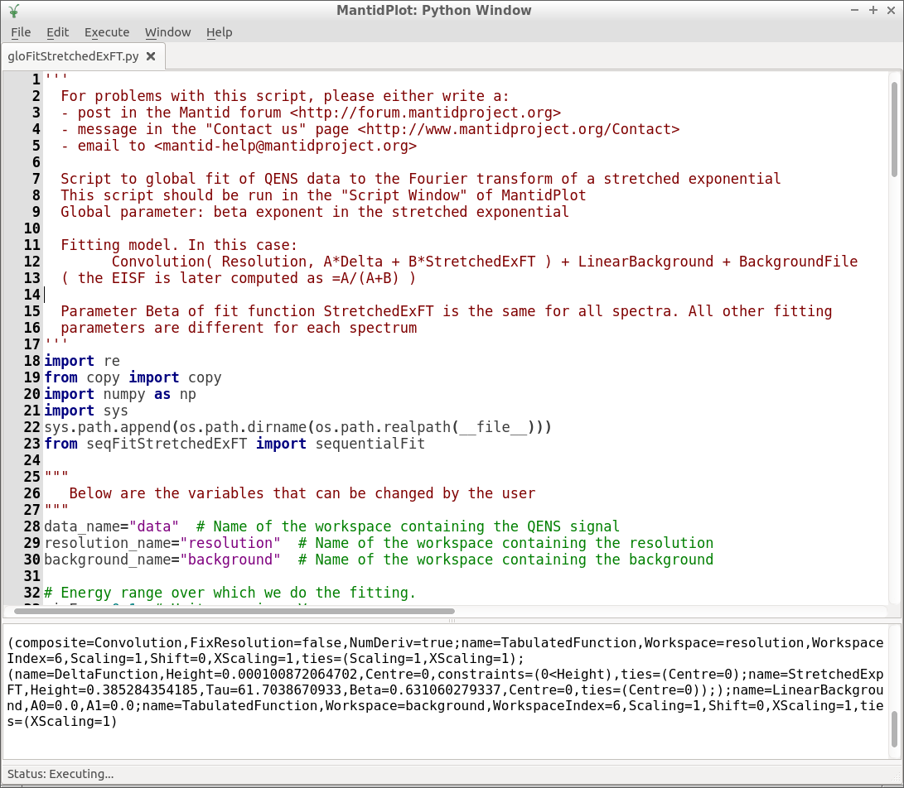
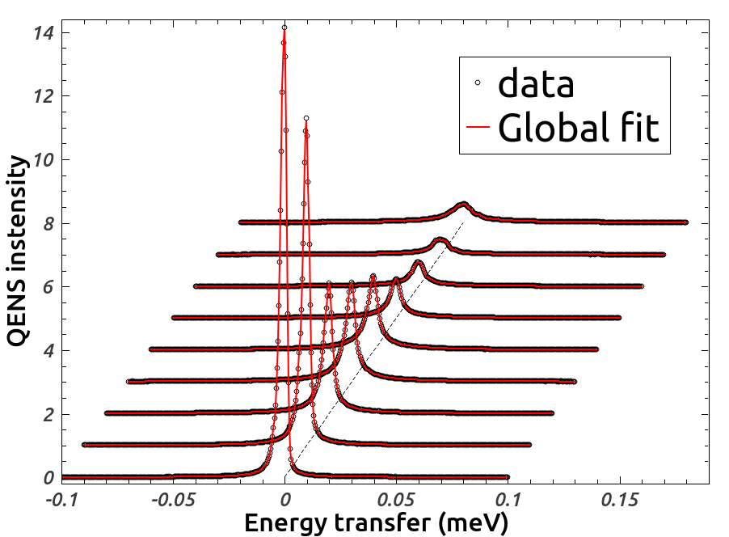
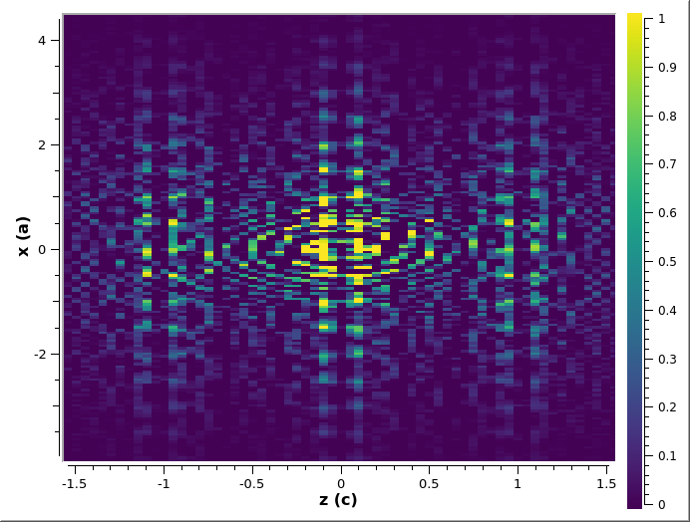
Other Highlights
Quasi Elastic
Global fitting
Collaborating on next interface, pyQt
Event filtering improvements
Single crystal peak integration improvements
Diffuse scattering
3D-ΔPDF
Q=1.9Å⁻¹
Q=1.7Å⁻¹
Q=1.5Å⁻¹
Q=1.3Å⁻¹
Q=1.1Å⁻¹
Q=0.9Å⁻¹
Q=0.7Å⁻¹
Q=0.5Å⁻¹
Q=0.3Å⁻¹
Benzil 300K, y=0.5

Slide 8
HFIR Needs
Continuous beam data structure
WAND2
Events
4 Circle
File Format
Data structure changes
Keeping instrument definitions for each run.
SANS
File format

Slide 9
Expanded Need and Use of Meta Data
New uses
UB matrix on Hyspec into Auto reduction
Table filling on SANS for guided reduction
Sample container information from sample data base on Powgen
Changing infrastructure to support use
Migration from Icat to ONCat
Remove limits on amount of Meta Data
Option to skip loading certain metadata

Slide 10
Preparing Mantid for the future
Robustness and speed improvements
Planning for Mantid 4.0
Algorithm renaming
Moving Mantid to more of a python styled library
Able to integrate easier with other libraries
Utilize exisiting tools
PANDAS, matplotlib, scipy
Work with existing neutron tools
SASview, REFL1d, neutronpy
Notes:
Matplot lib naturally does non orthogonal axes.
Neutronpy is our chosen TAX solution.

